Slide 1
Test Driven Development in DXL
Introduction to the
DxlUnit Framework©

Slide 2


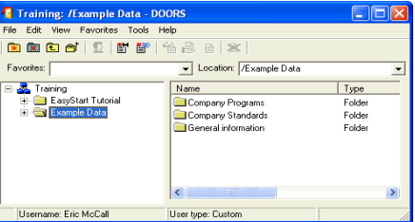
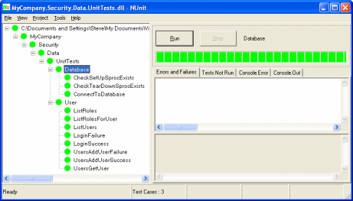
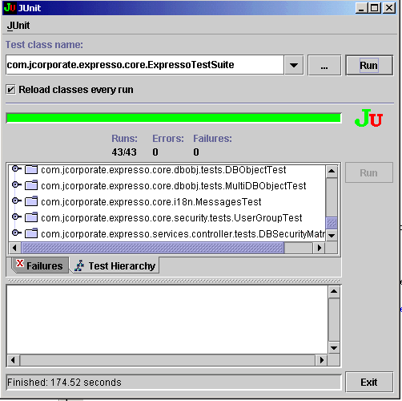

Test Driven Development in DXL

Slide 3
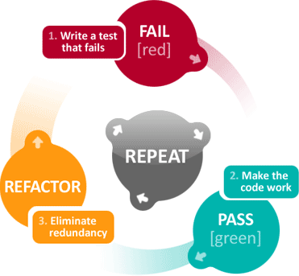
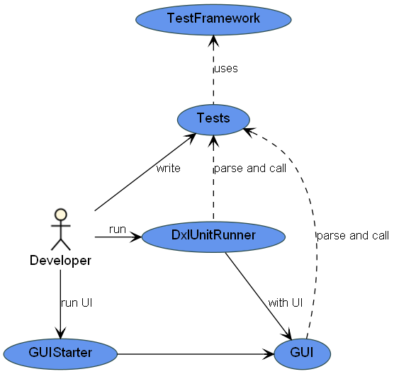
Test Driven Development in DXL
Part 1:
TDD Overview
Part 2:
The DxlUnit Framework
The Dxl Unit Framework © Designed by Dipl.-Ing. (FH) Bernhard Bold

Slide 4
Test Driven Development
Goals
Functional Quality
Script is free of errors
Script does what it‘s designed for
Structural Quality
Good design
Good code structure

Slide 5
Test Driven Development
Goals
Definition
Tests
automatable
repeatable
Test Environment
leave no trace
Script delivery
never without tests

Slide 6
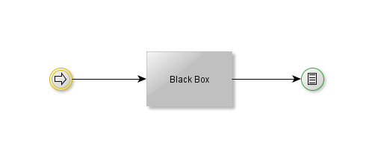
Test Driven Development
Goals
Definition
Principles
Each function call changes the system
Each change can be measured
Directly
Indirectly

Slide 7
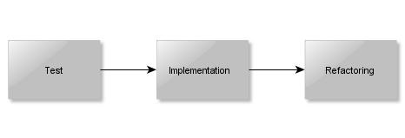
Test Driven Development
Goals
Definition
Principles
Development
Development order
Write a test
Implement the functionality
Refactor the code

Slide 8
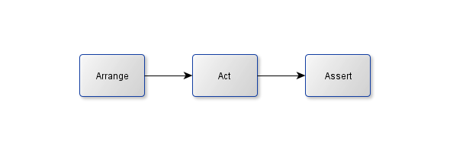
Test Driven Development
Goals
Definition
Principles
Development
AAA Pattern
Parts of a test
Arrange Setup a defined test environment
Act Call the function to test
Assert Assure the system changes are correct

Slide 9



Test Driven Development
Goals
Definition
Principles
Development
AAA Pattern
Test chain
Development cycle
Write the test.
Implement the functionality.
Refactor the code.

Slide 10
The DXL Unit Framework
Overview
Overview

Slide 11
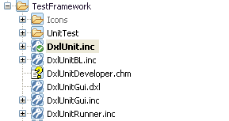
The DXL Unit Framework
Overview
Components
Components
Script | Description
DxlUnit.inc | Assertions.
DxlUnitBL.inc | Common methods.
DxlUnitRunner.inc | Starting script.
DxlUnitGui.inc | The UI
DxlUnitGui.dxl | Independent UI.
DxlWorkspace.inc | Define the base path for your framework.

Slide 12
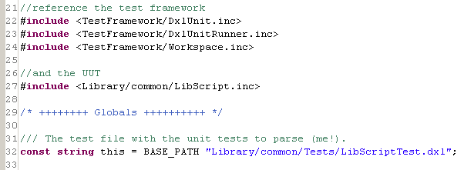
The DXL Unit Framework
Overview
Components
Test file Creation
Creating a test script
Steps
Create a file to be tested (uut.inc)
Create a test file (uutTest.dxl)
Declare variable for the test file (this)
Include the unit framework
Include the file to test
To demonstrate the principles of the
framework we don‘t use a UUT file here.

Slide 13
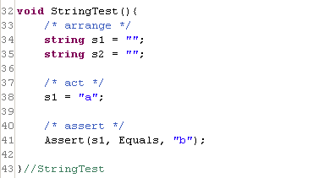
The DXL Unit Framework
Overview
Components
Test file Creation
Create Test
Creating a test
Conditions
Method name ends with ‘Test’
Method has no parameter
Return type is void

Slide 14

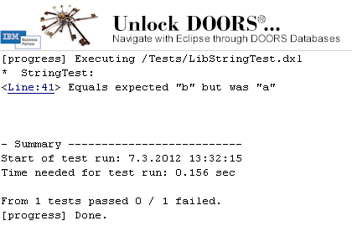
The DXL Unit Framework
Overview
Components
Test file Creation
Create Test
Run Test 1
Run the test in console
At the end of the script write the following
Start the script.

Slide 15

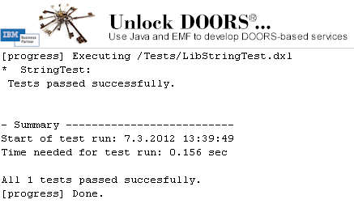
The DXL Unit Framework
Overview
Components
Test file Creation
Create Test
Run Test 1
Run Test 2
Succeeding test
Fix the error.
Start the script.

Slide 16
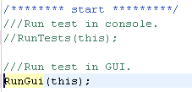
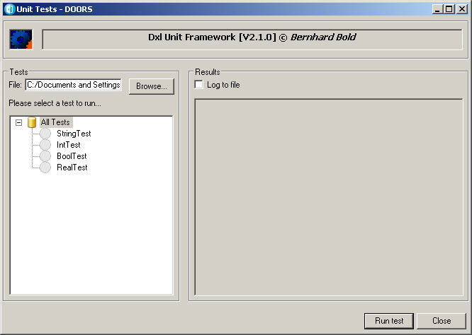
The DXL Unit Framework
Overview
Components
Test file Creation
Create Test
Run Test 1
Run Test 2
The GUI
Run the GUI
Activate the GUI.
Start the script.

Slide 17
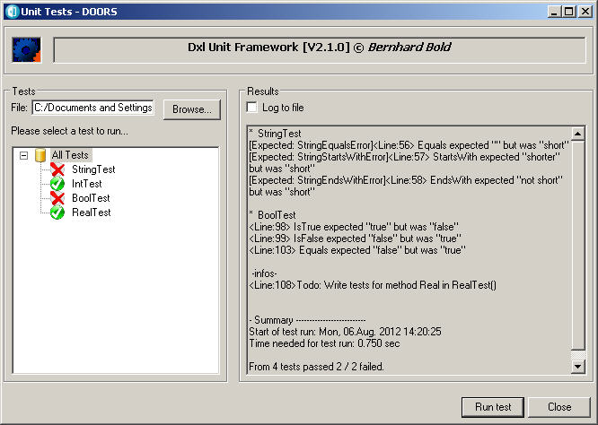
The DXL Unit Framework
Overview
Components
Test file Creation
Create Test
Run Test 1
Run Test 2
The GUI
Run GUI Test
Run the test in the GUI
Click on ‘Run test’, or double click test to run.

Slide 18
The DXL Unit Framework
Overview
Components
Test file Creation
Create Test
Run Test 1
Run Test 2
The GUI
Run GUI Test
Assertions
Assertions
Assert(actual, comparison [, expected][, summary]);
actual: The current value.
comparison: Test function (Equals, IsNull, IsTrue).
expected: The expected value.
summary: Textual description on error.
Null and boolean checks don’t need the expected parameter!
Functions
Function | Description
Equals | Check for equality.
IsNull, IsNotNull | Check for null.
IsTrue, IsFalse | Boolean checks.
StartsWith | String begins with a string.
EndsWith | String ends with a string.
Contains | String contains another.

Slide 19
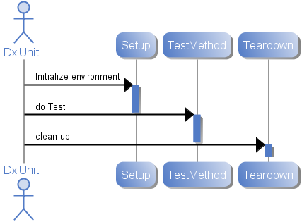
The DXL Unit Framework
Overview
Components
Test file Creation
Create Test
Run Test 1
Run Test 2
The GUI
Run GUI Test
Assertions
Setup & Teardown
Setup & Teardown
Arrange each test.
Setup()
Prepare environment for each test.
Teardown()
Clean up environment.

Slide 20
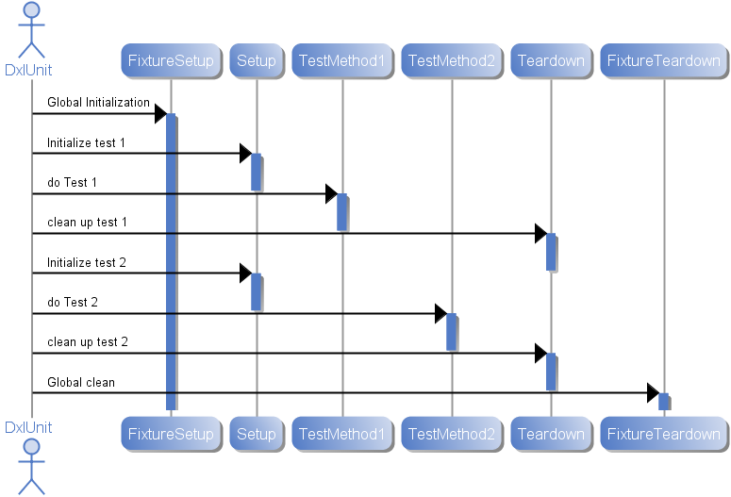
The DXL Unit Framework
Overview
Components
Test file Creation
Create Test
Run Test 1
Run Test 2
The GUI
Run GUI Test
Assertions
Setup & Teardown
FixtureSetup & FixtureTeardown
FixtureSetup & FixtureTeardown
Arrange environment for all tests.
FixtureSetup()
Prepare environment before first test.
FixtureTeardown()
Clean up environment after last test.

